Slide 1
Recommender Systems Based on Reviews and Product Interactions

Slide 2
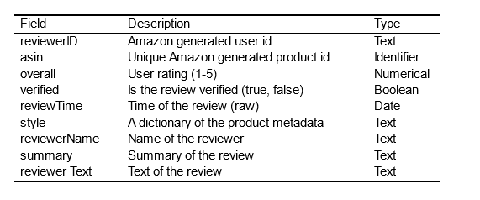
Dataset Description
2014 Amazon Review Dataset
From: Jianmo Ni, UCSD
There are 3,176 users recorded reviews over ten years.

Slide 3
Goal
Text Classifcation
Use Sentiment Analysis to identify positive review
keep the product that have positive review
Prepare sequence data
Tokenization & Encoding of asin
Create sequence and labels features tensor
Build the model
Methodology: Recurrent Neural Network (LSTM)
Prediction
Given the user history, provided the asin from recommender system

Slide 4
Text Classifcation
Here we utilized the TextBlob to perform sentiment analysis on a dataset containing textual reviews.
It assesses the polarity and subjectivity of a text where:
where -1.0 means negative sentiment and
1.0 means positive sentiment.
0 means Neutral

Slide 5
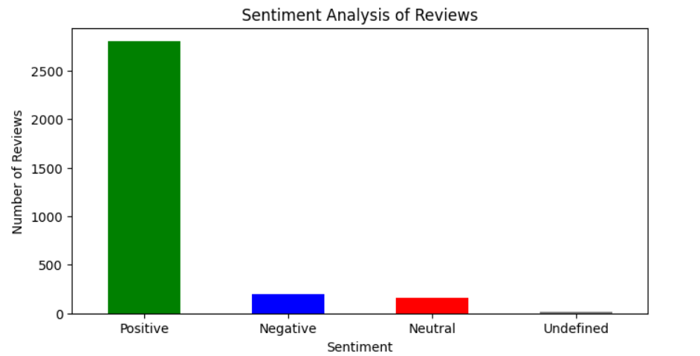
Sentiment Analysis of Review
The majority of reviews are classified as Positive, with the count exceeding 2800 reviews. This can be seen as a strong positive signal for the Amazon product line. The relatively low occurrence of Negative and Neutral reviews suggests that there are fewer concerns or issues being raised by users.

Slide 6
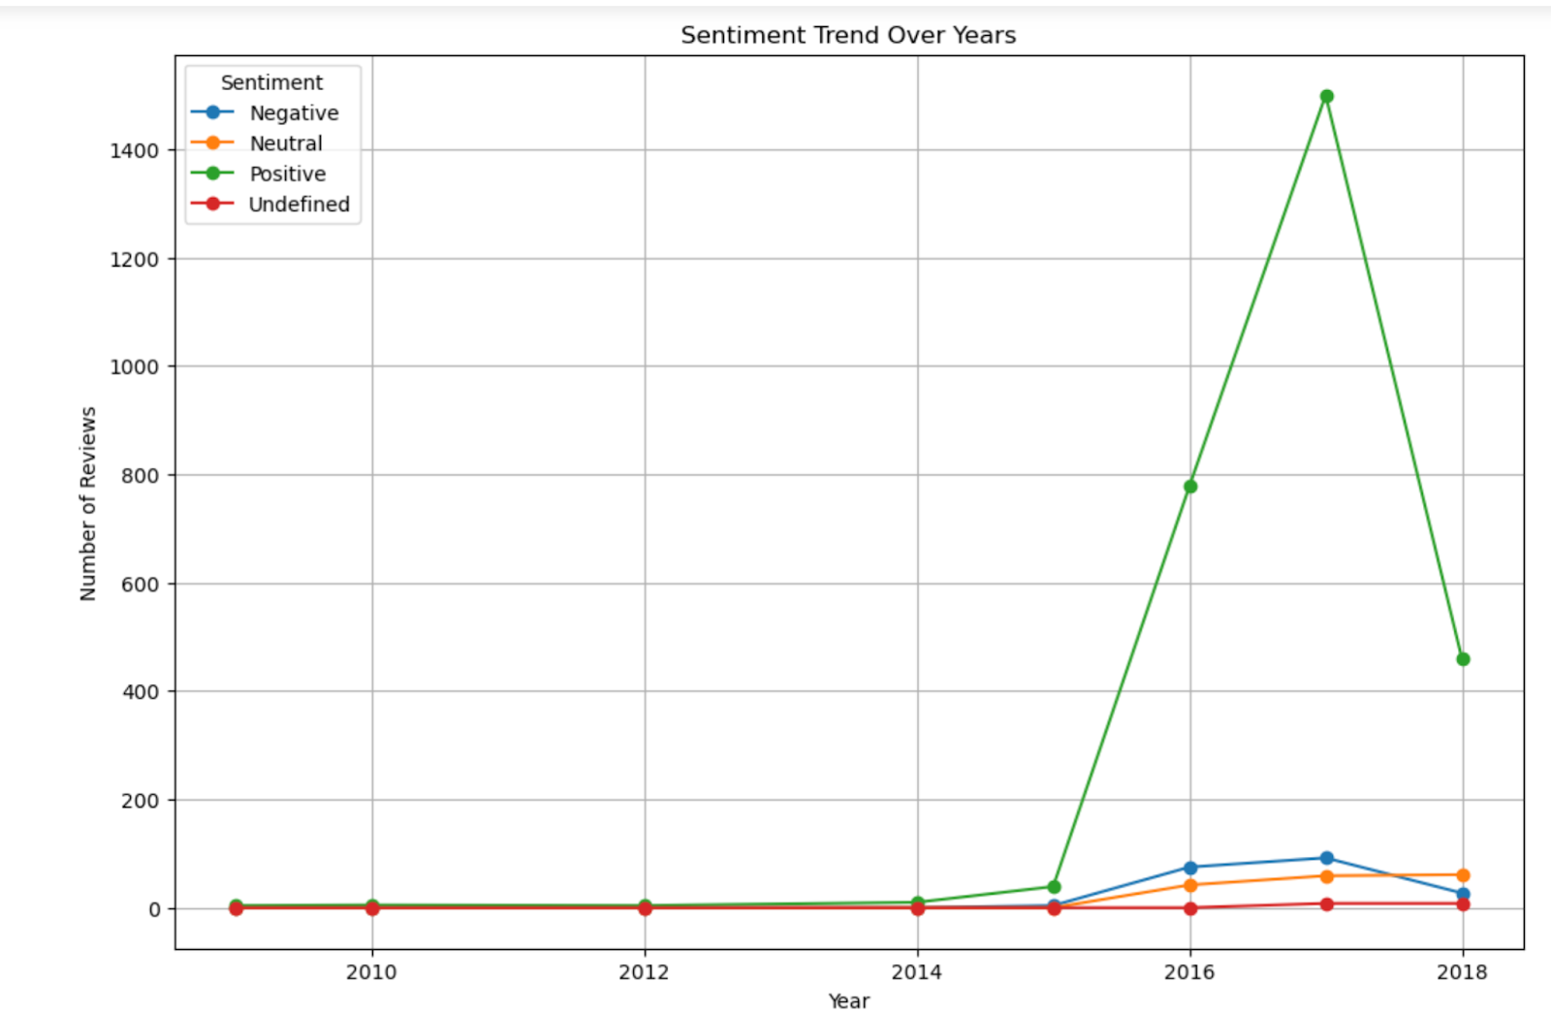
Sentiment Trend Over Years
The "Positive" sentiment improved dramastically from 2014, peaked sharply in 2017, suggesting a highly favorable response to a product or event, before dramatically declining by 2018. "Neutral" sentiment shows a steady increase over the years, while "Negative" and "Undefined" sentiments remain consistently low throughout the period.

Slide 7
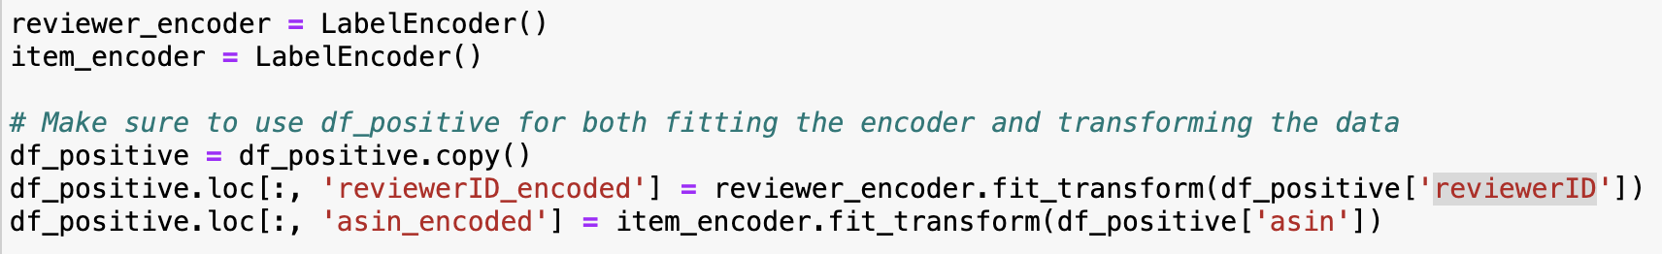
Prepare sequence data
Tokenization & Encoding of asin and reviewerID
Transform asin and reviewerID from string to integer

Slide 8
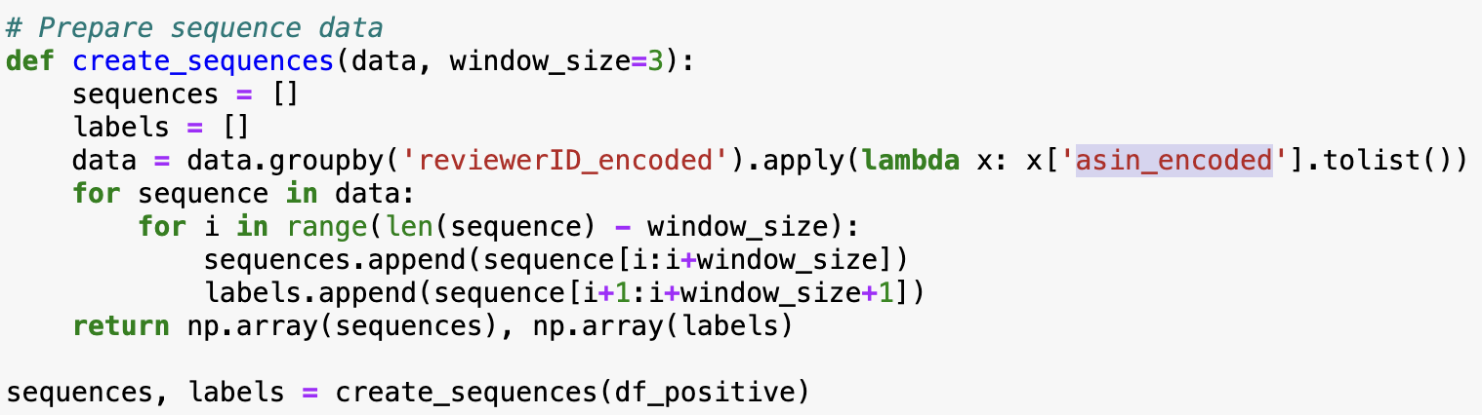
Prepare sequence data
Create sequence and labels features tensor
Group the dataset by reviewerID_encoded and transform each asin_encoded to list
Create the sequence and corresponding labels

Slide 9
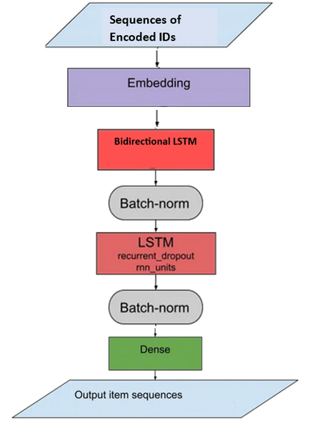
Build the Model
Recurrent Neural Network (LSTM)
First LSTM layer we use bidirectional lstm since it has the capability of utilizing information flowing from the past as well as future timestamps essentially providing credible reverse evaluation figures which also helps in cross validation of the rsult

Slide 10
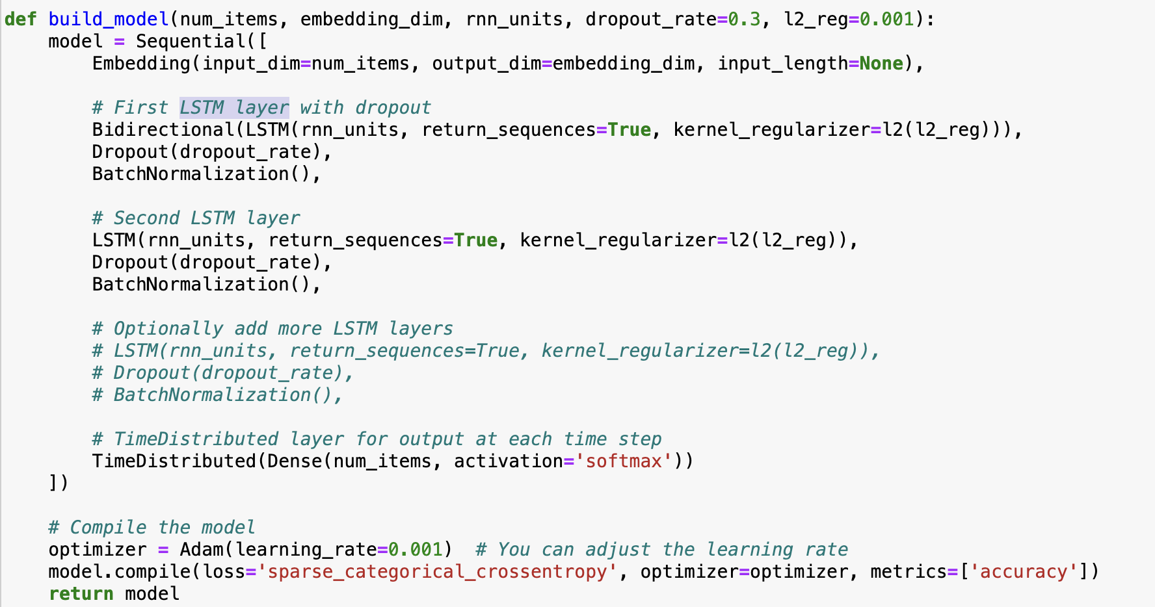

Slide 11
Hyperparameter
Loss function: sparse_categorical_crossentropy
optimizer: Adam with learning_rate=0.001
dropout_rate = 0.3
embedding_dim = 64 (The size of the vector space in which words will be embedded)
rnn_units = 128 (The number of units in each LSTM layer.)
batch_size = 128
num_items = The max value of asin_encoded +1(The maximum number of unique items that will be encoded using the embedding layer.)

Slide 12
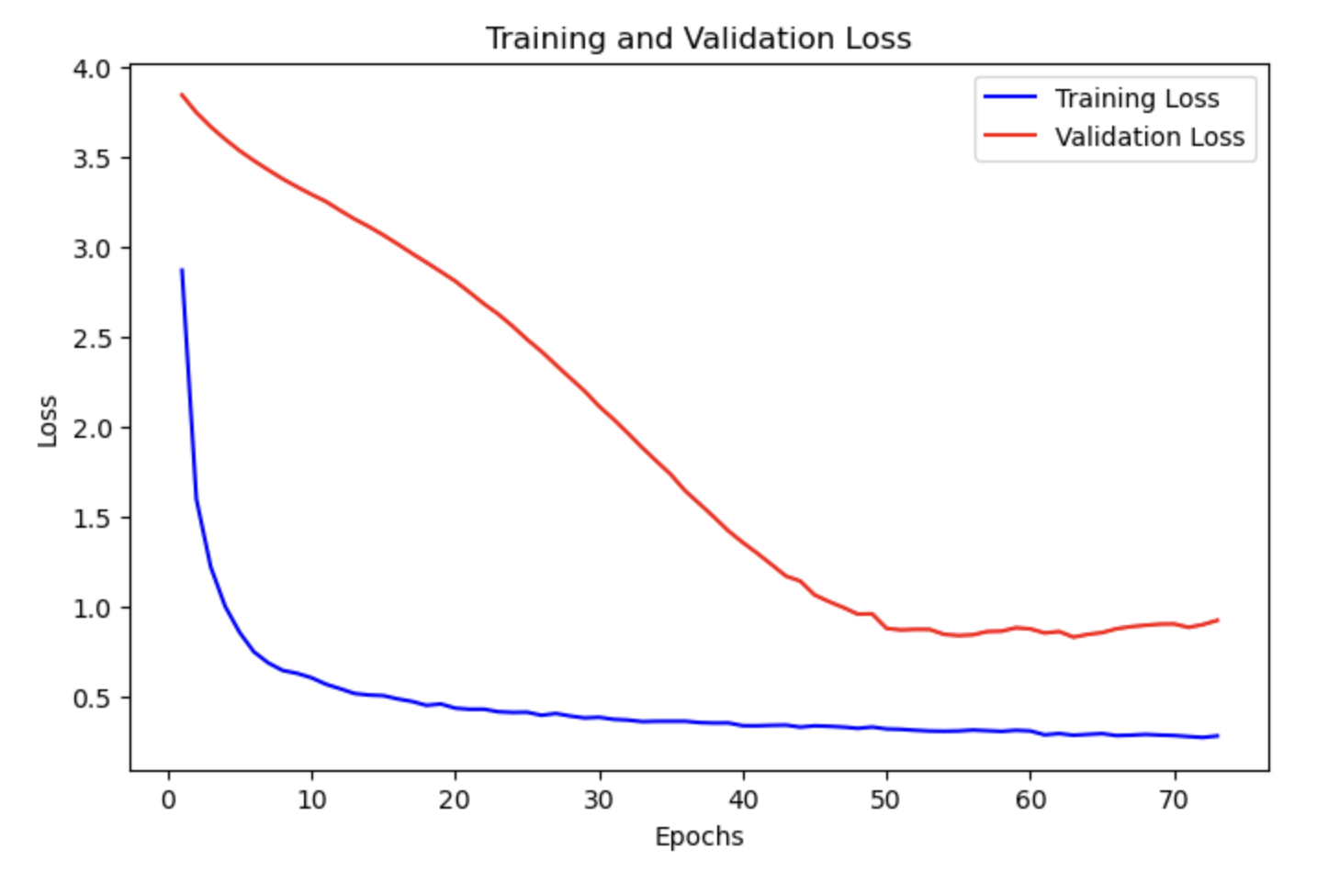
Training and Validation Loss
5-Fold Cross-Validation

Slide 13
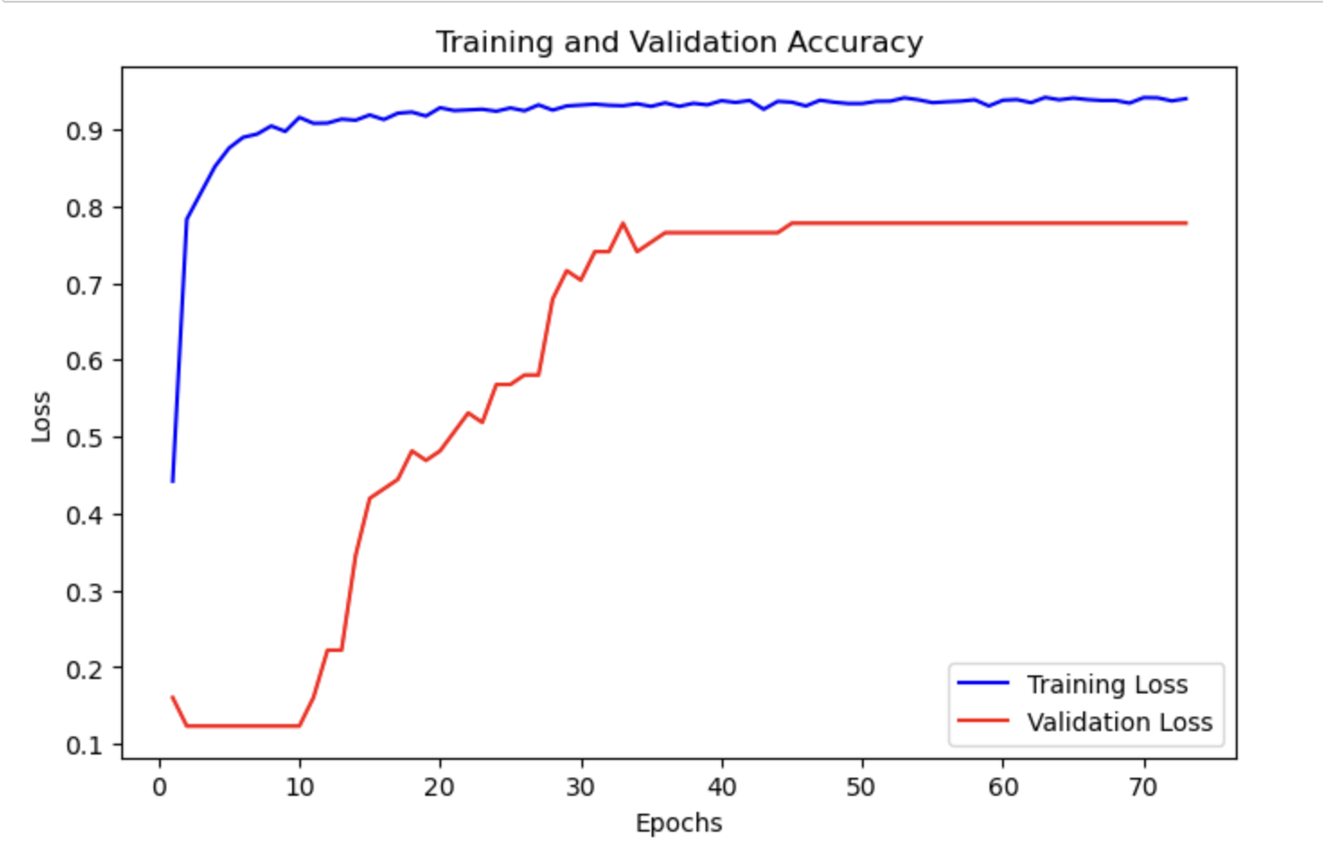
Training and Validation Accuracy

Slide 14
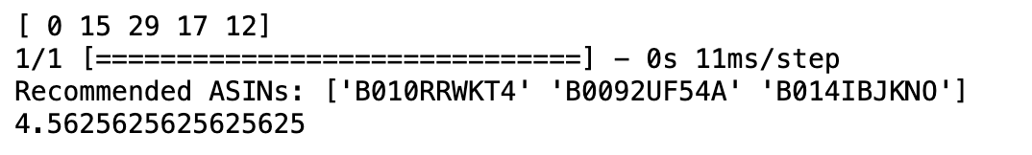
Prediction
Given the user history, provided the asin from recommender system
input_sequence = ["B000K2PJ4K", "B005AGO4LU", "B016XAJLVO", "B009MA34NY", "B001LNSY2Q"]

Slide 15
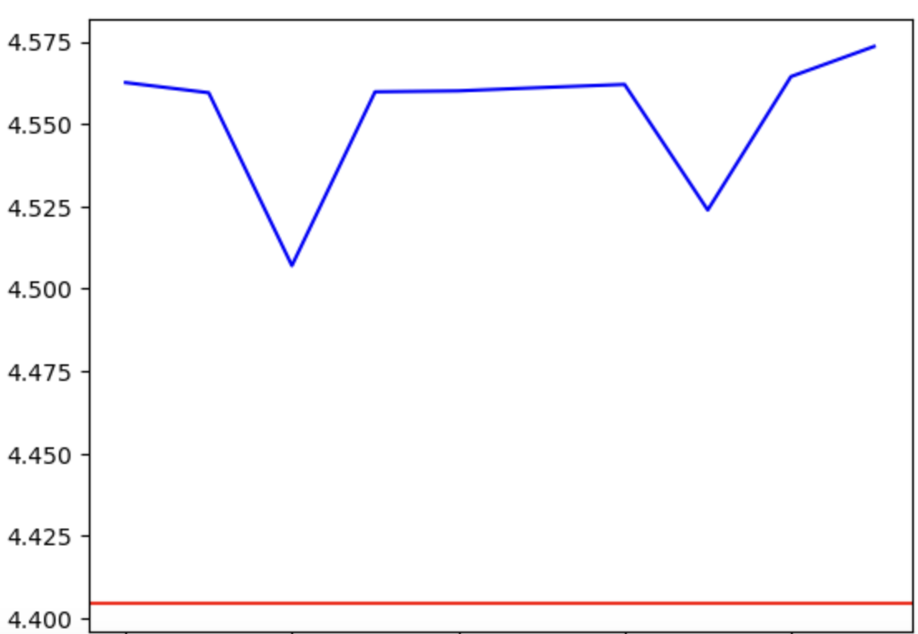
Check the Overall Score of Product
Once we have the Recommended ASINs, We have to check is Recommended ASINs are good product base on its Overall Score.
Assume We have 100 user’s history purchase record, then compare the Average Overall Score of Recommended ASINs with the mean of Overall score for our data is 4.40.

Slide 16
Questions for future research
What else algorithm can work for Recommender Systems
What Happen if user don’t have enough purchase history

